Slide 1

WHY ROME WAS BORN IN ROME
Antonio Perrone
Twenty-three centuries after Quintus Ennius and twenty centuries after Titus Livius, modern electronic cartography allows us to formulate a new hypothesis about the prehistoric origins of the city of Rome.

Slide 2
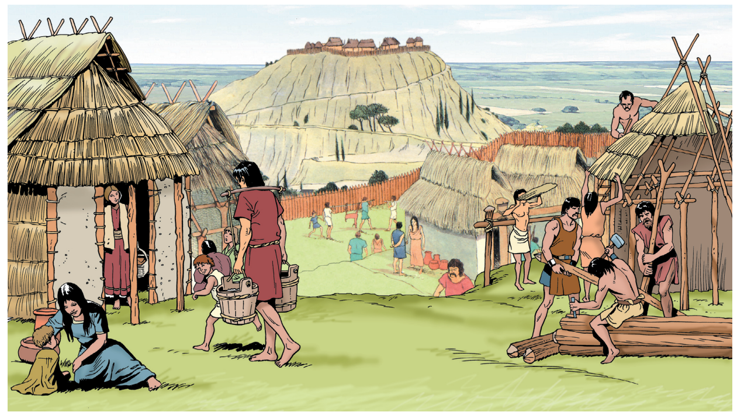
It is possible to hypothesize that Rome was not originated by a simple – spontaneous or forced - aggregation of the neighboring villages

Slide 3
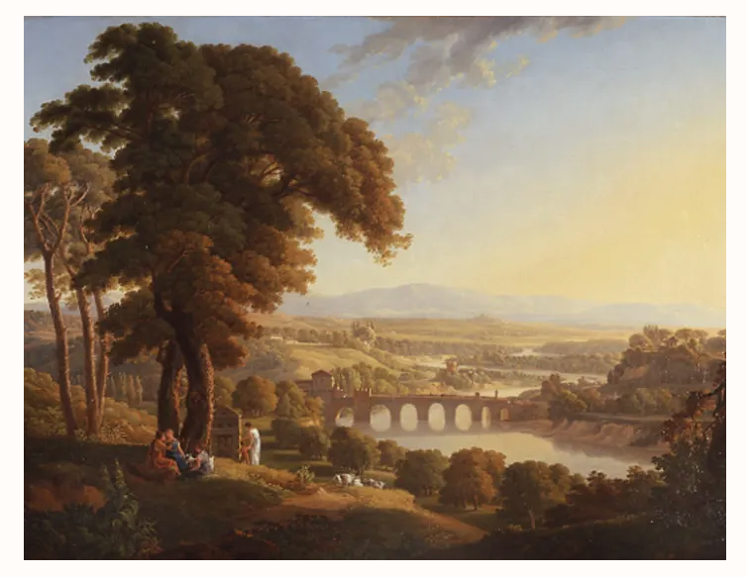
It would seem that Rome was born as a simple privileged stopover space along an ancient, protohistoric, pedestrian path that ran along the coasts of the Mediterranean Sea.

Slide 4
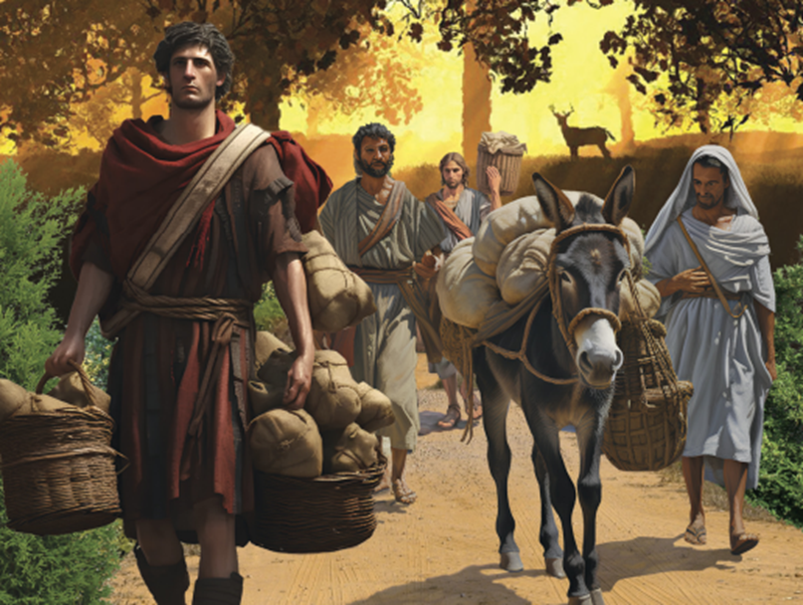
Little by little, along this path, at every obstacle - be it a river, a valley, a cliff or a marsh - tavern keepers, innkeepers, guides, porters and shopkeepers began to provide their services and sell their goods to the travelers

Slide 5
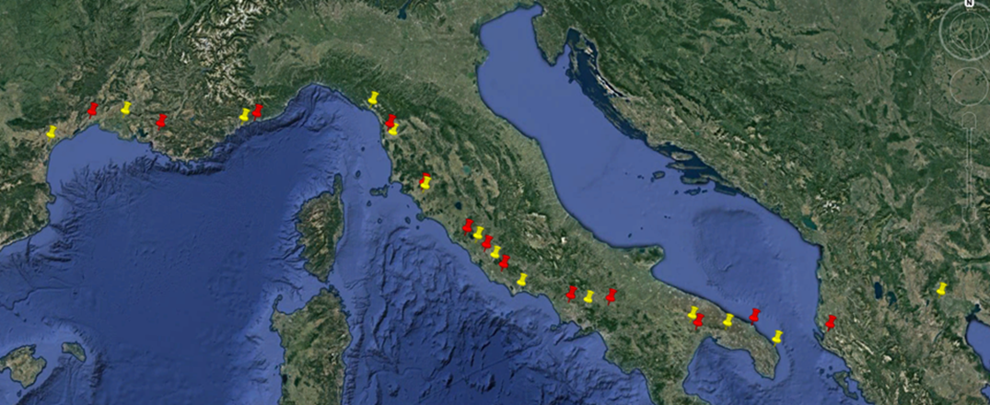
So, it is possible to think that this ancient pedestrian path, consolidating over time, gave rise - in its nodes - to some of the most important and fascinating cities that we know today.

Slide 6
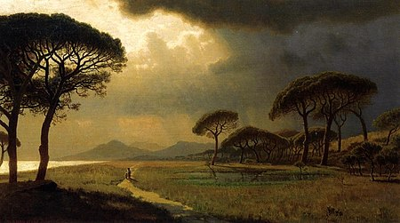
The path, among others, crossing the Tiber founded Rome, crossing the Arno founded Pisa, crossing the Rhone founded Arles and also founded Aix-en-Provence, Narbonne, Vlora, Edessa and Kavala

Slide 7
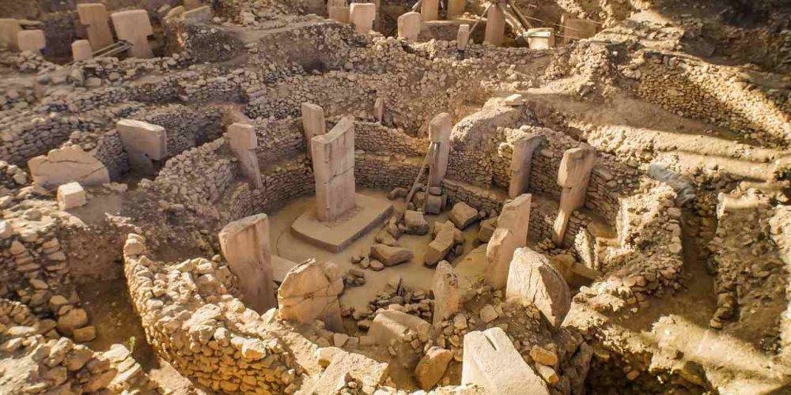
Outside the Mediterranean Sea similar paths may have given rise to Xi'an, Samarkand, Tashkent, Gobekli Tepe, Karahan Tepe and Antioch

Slide 8
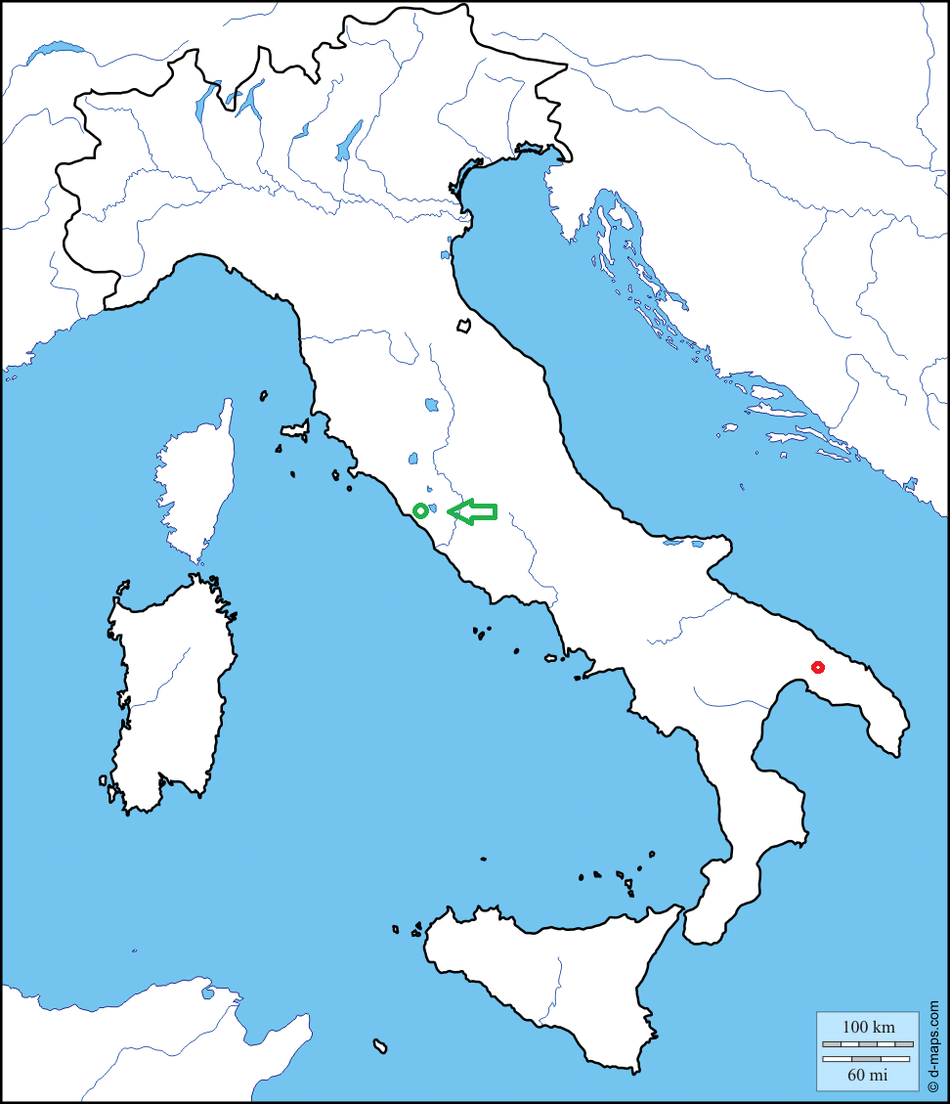
This hypothesis was born by an intuition. I observed the position of Rome at the end of the straight line of the final part (starting from Brindisi) of the Via Appia.

Slide 9
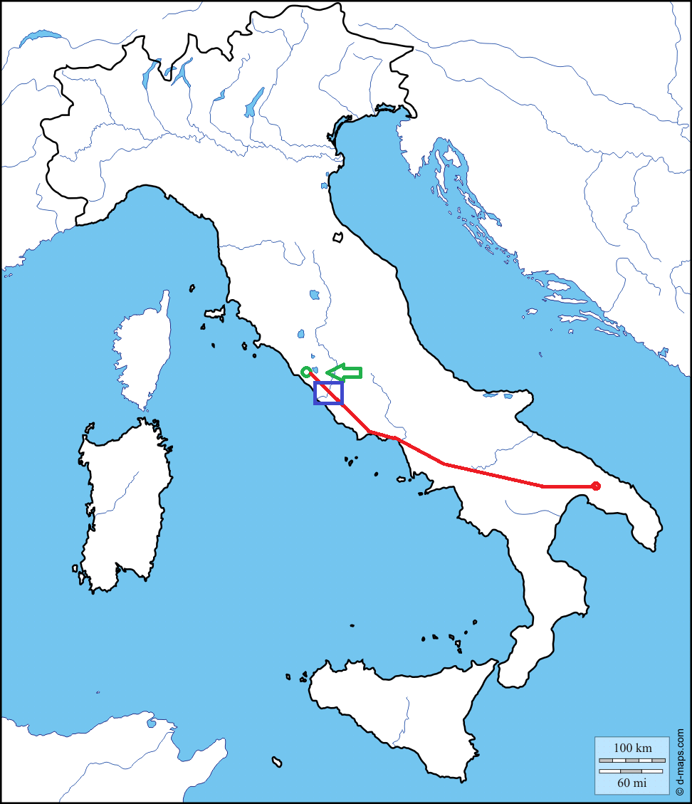
This observation suggested me to extend this straight line

Slide 10
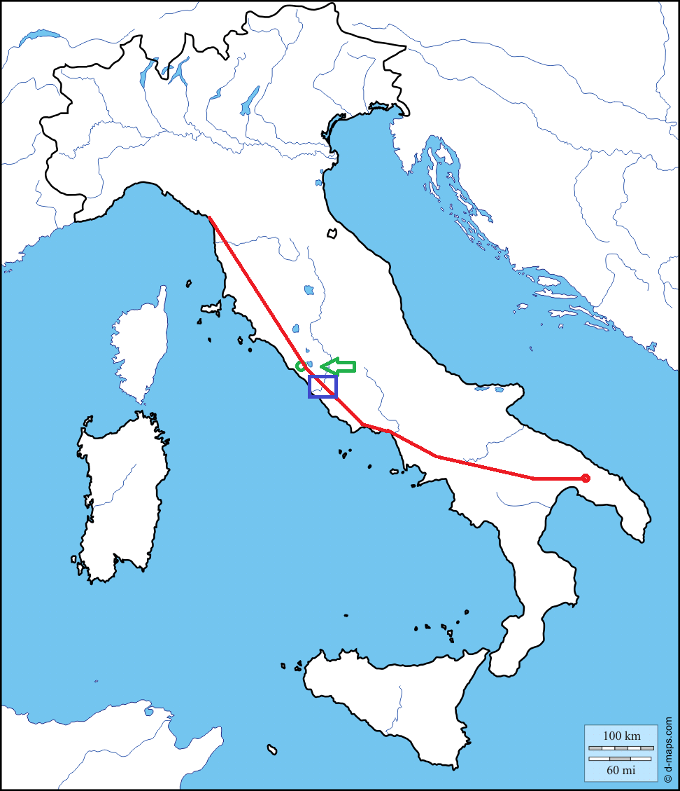
So I have seen that this straight line reaches the ancient port of Luni, in Liguria, near La Spezia

Slide 11
Several surveys and the use of the modern cartographic tools convinced me that this straight line, walked by foot, was one day and half shorter than the costal way

Slide 12
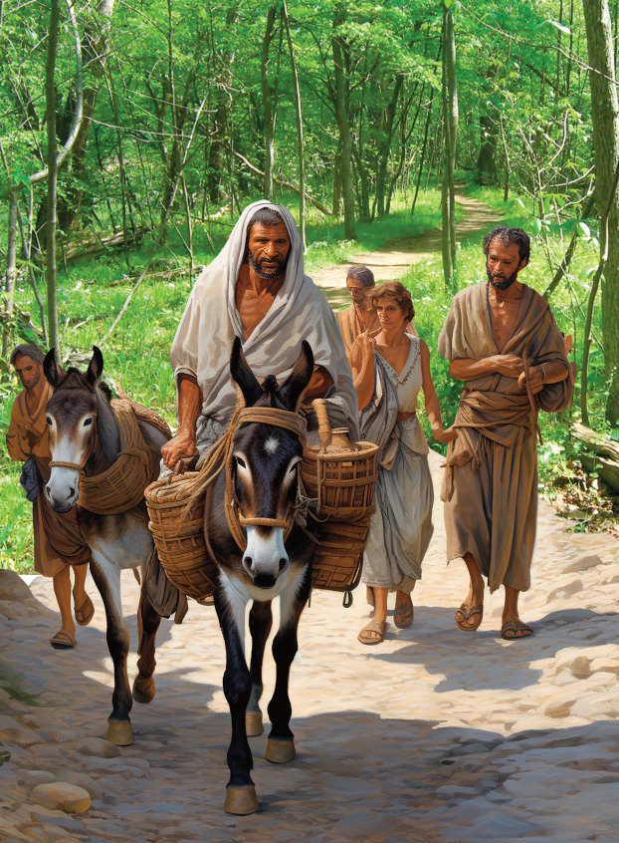
After this, I have checked, in literature, the existence of traffic between the Provence and the Campania, between the Greece and the Liguria, between Massalia and the Phoenician

Slide 13
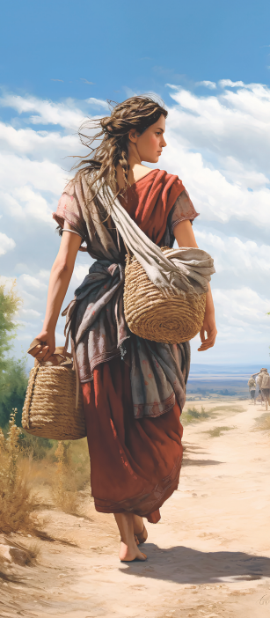
In the period in which - during the winter - sailing by sea was impossible or even forbidden, it is reasonable that the people went on foot by land. Consider the case of a merchant who wants to order a shipload of olive oil for when the next season will be again navigable.

Slide 14
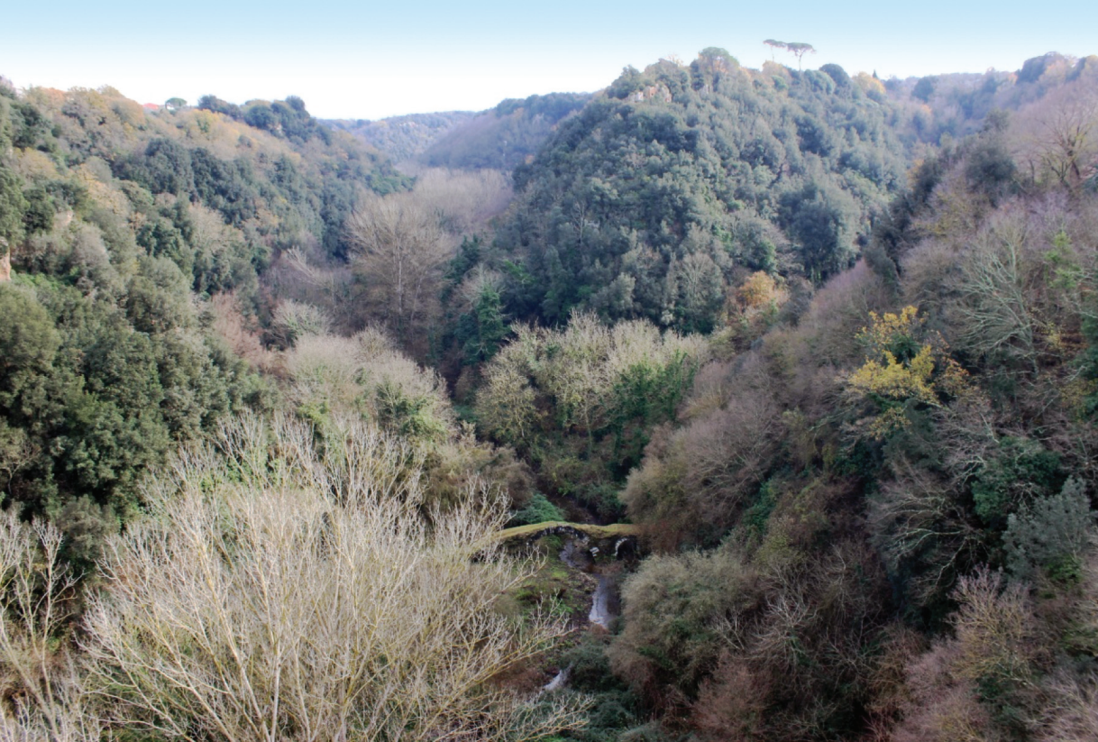
This phenomenon will have had very specific consequences at some points along the main stretches of road. A ford, a cliff, a deep valley will have slowly discouraged the wayfarers from completing the stage late in the evening.

Slide 15
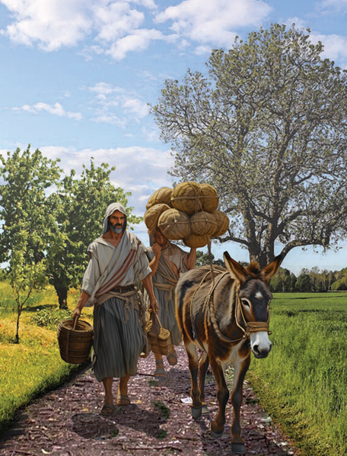
At the river crossings, the boatmen will have built their first huts; the innkeepers will have set up kitchens and sleeping places and the merchants will have begun to consider these places as privileged sites for their trades

Slide 16
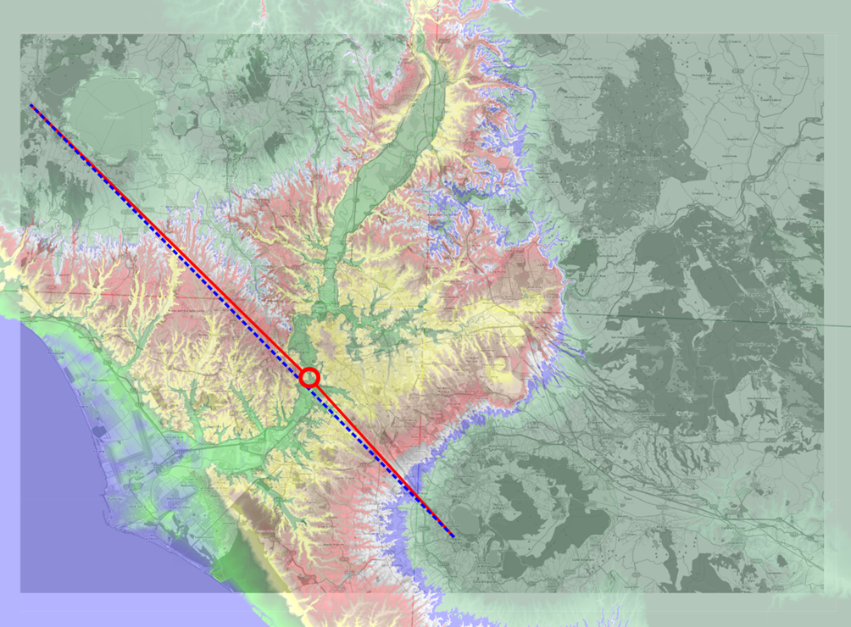
Little by little, leaving the two lakes of Bracciano and Albano to the east, the path formed the first urban settlements on the narrowest point of the swampy Tiber

Slide 17
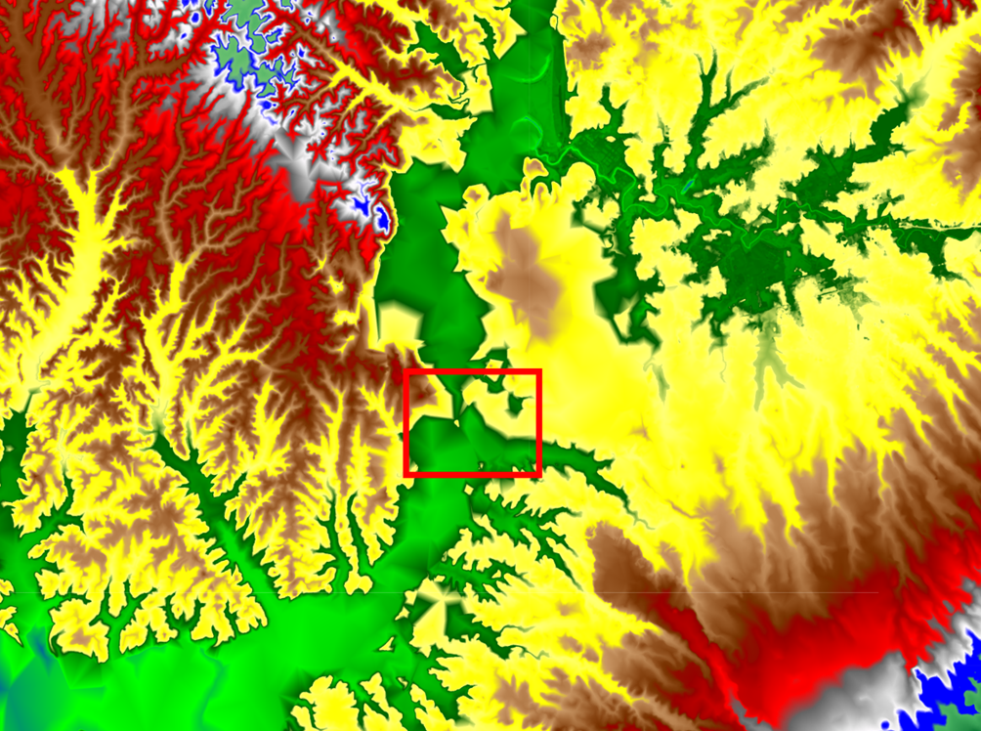
The narrowest part of the Tiber Valley is highlighted in false colors

Slide 18
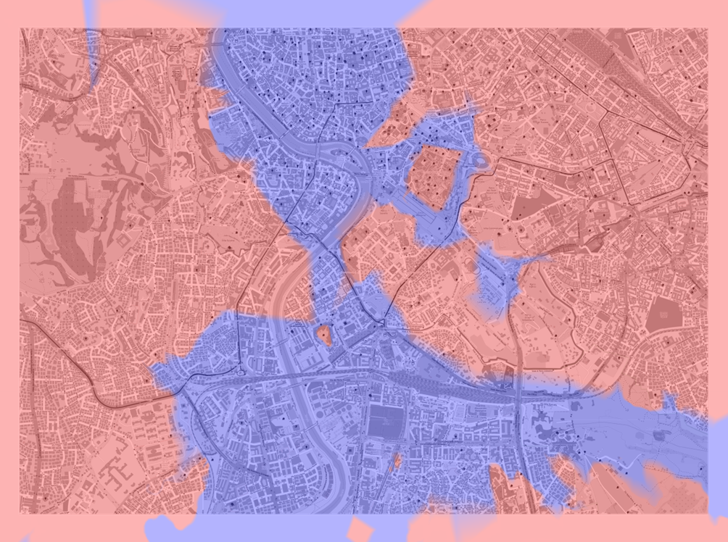
The same place drawn on a map of today's Rome

Slide 19
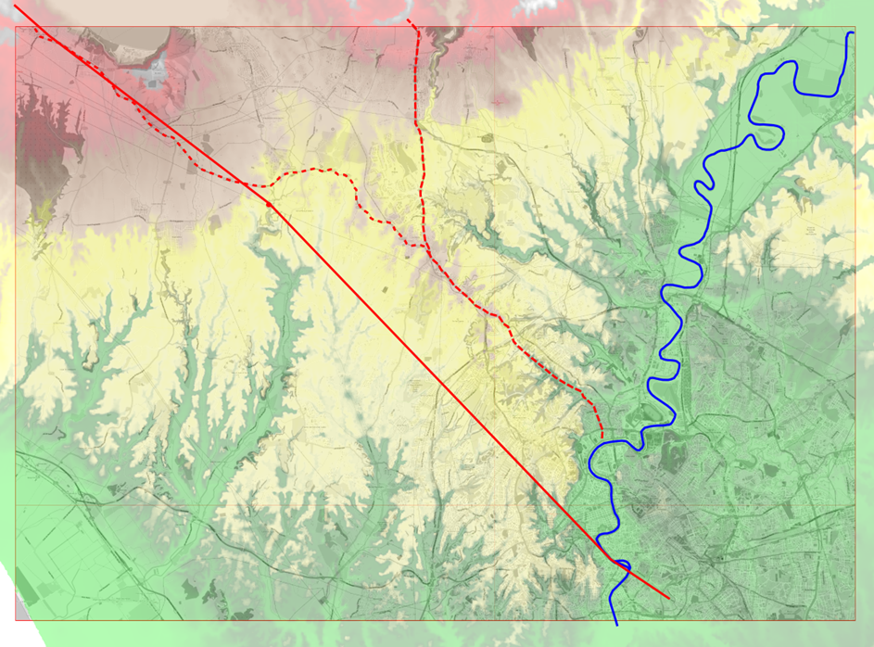
The spread of carts pulled by the draft animals forced the abandonment of the steeper path in favor of less steep roads. Here the passage of the traffic from the pedestrian straight path to the current Via Cassia and Flaminia

Slide 20
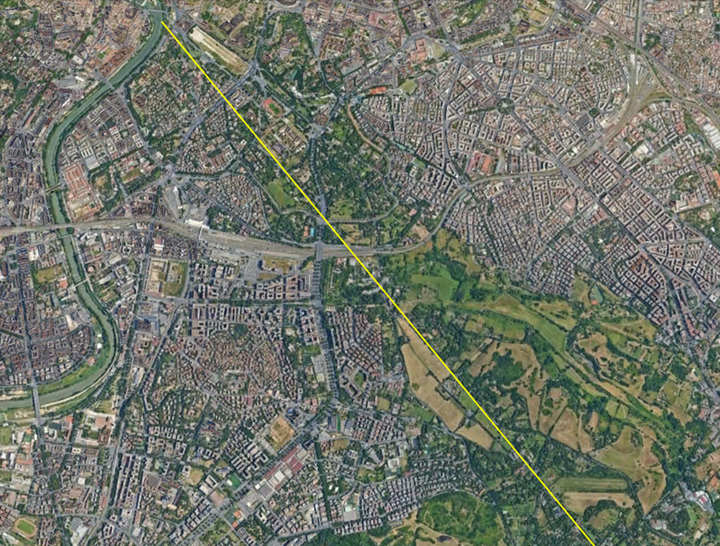
The path between the semi-final stretch of the Appian Way and the site of the Cloaca Maxima, supposed place of the Sublicio Bridge

Slide 21
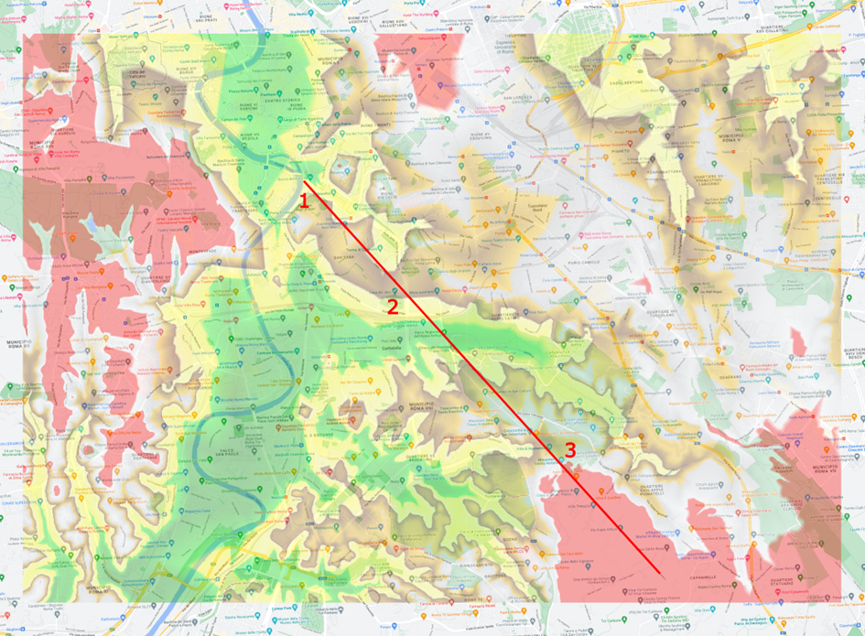
The map shows the slopes between the Circus of Maxentius 3 and the Cloaca Maxima 1.
The hilly area 2 obliged to deviate the cart traffic through the Porta San Sebastiano and Porta Capena.

Slide 22
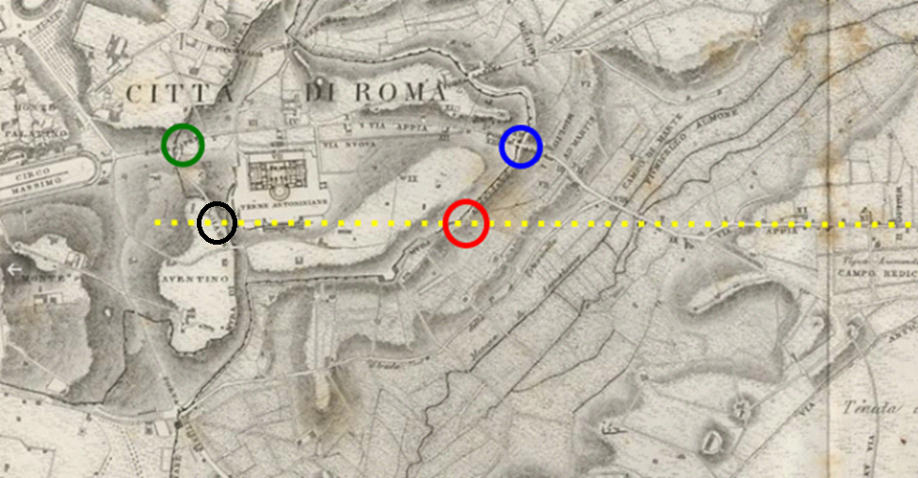
In blue Porta San Sebastiano, in green Porta Capena, in red Porta Ardeatina and in black the possible site of Porta Naevia

Slide 23
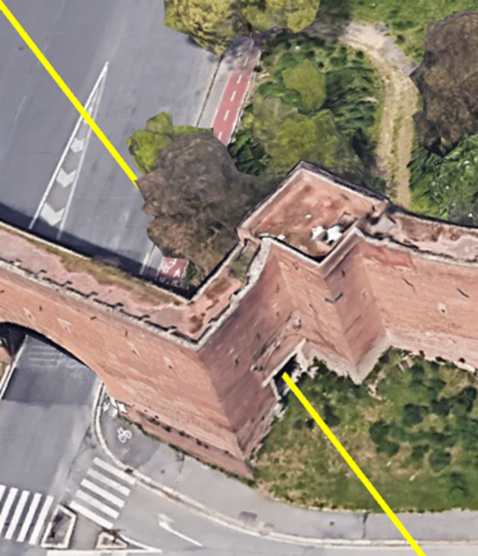
A relic of the path is represented by the Porta Ardeatina along the Aurelian Walls, while the Porta Naevia, along the Servian Walls is now disappeared.

Slide 24
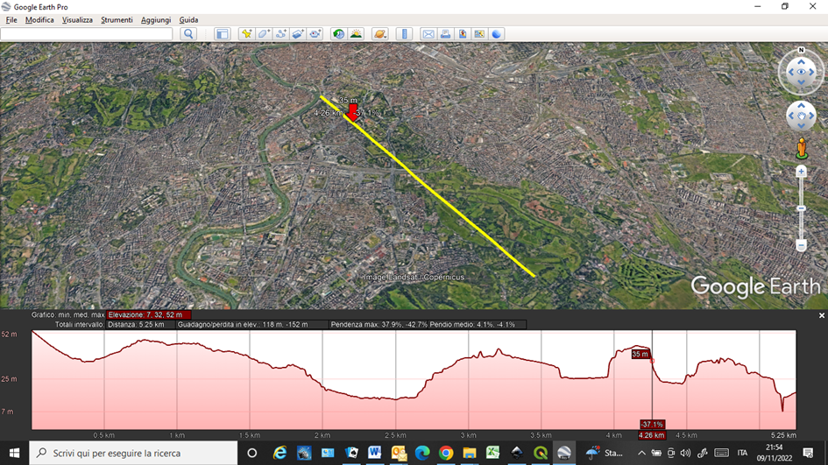
The altimetric trend of the path inside Rome: the graph evidences the slope between the monastery of Santa Balbiana and the FAO Building

Slide 25
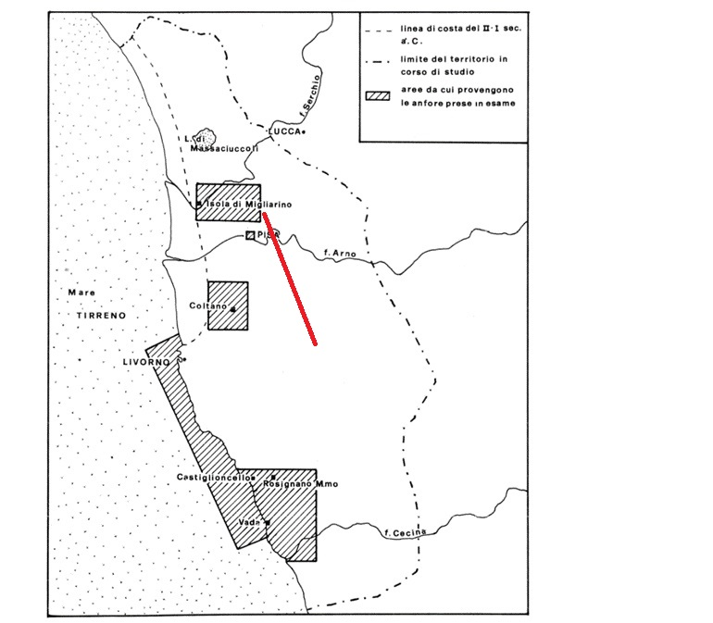
Pisa and Rome show the same origins: in red the path. Pisa never was on the seaside. Here the city two secles B.C. (the base of the map is From Camilli and Gambogi)

Slide 26
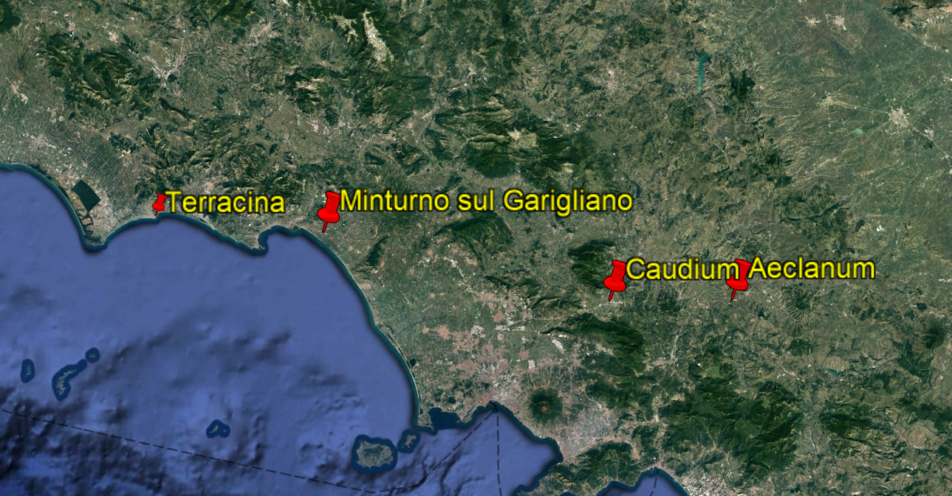
The same situation for Minturno at the crossing of the Garigliano River

Slide 27
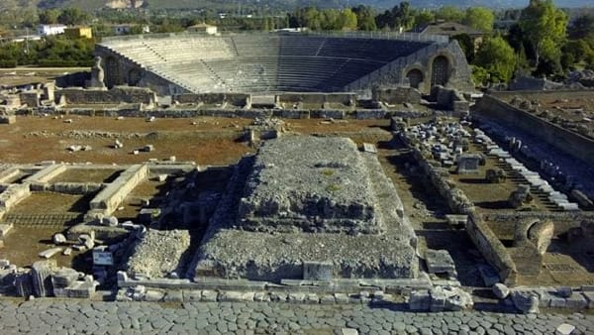
Every scientific hypothesis request a discussion and a confirmation. In this case the hypothesis has been that exchanges were between the today France and the Middle East and that a path was existed between Luni in Liguria and Terracina. Along this path, Rome arose spontaneously at the crossing of the River Tiber.

Slide 28
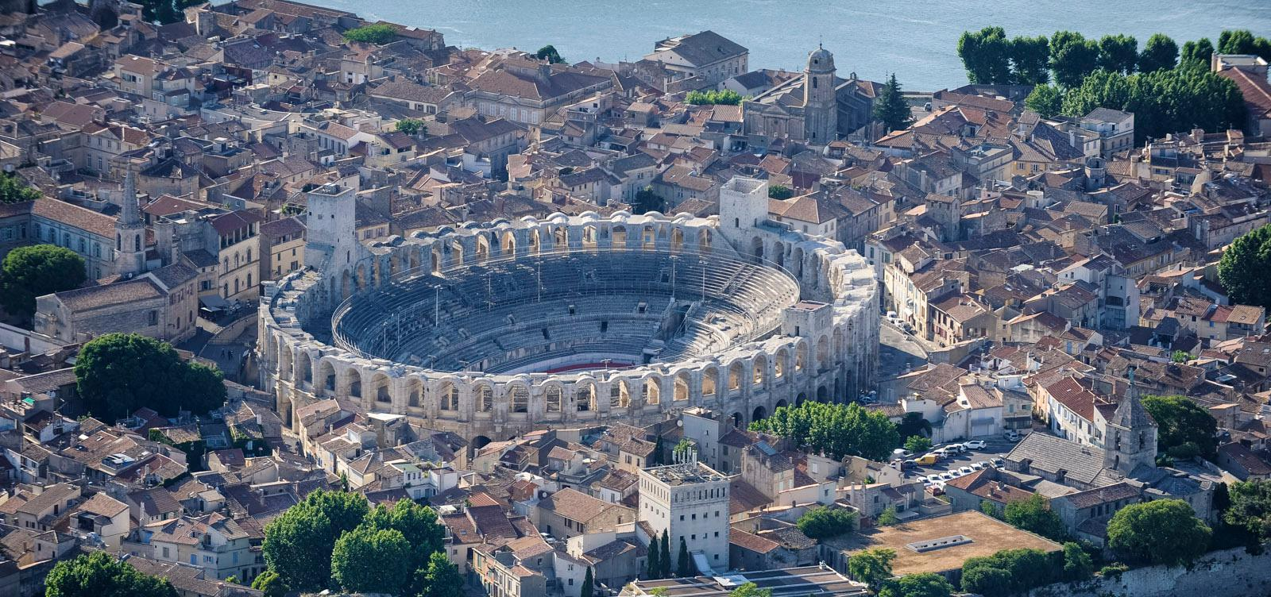
The confirmation of the first hypothesis of the path has been, - among the others - to find, during this research, Pisa on the Arno River and far from the seaside, Pezza Petrosa between Brindisi and Gravina di Puglia, Capua Vetere at the crossing of the Volturno, Minturno at the crossing of the Garigliano, Roselle near the Ombrone River, Arles on the Rhone.

Slide 29
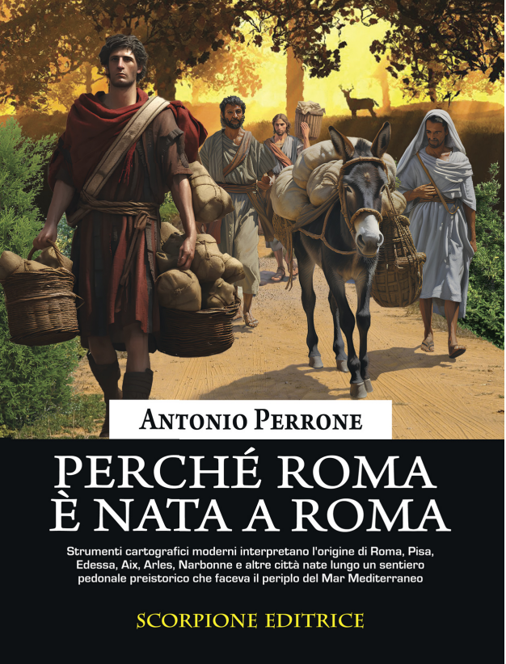
All of these and other sites are better specified in the volume Perché Roma è Nata a Roma edited by Scorpione, Taranto in 2024

Slide 30
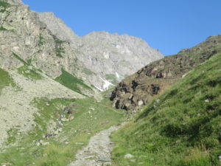
It is beyond my forces to use more sophisticated means such as a georadar to further confirm my hypotheses. In the book there are several sections of road that end abruptly. It is at those sites that one should drill cores and use the georadar. It is with this method that, 2300 years later, Professor Mahony has been able to identify with reasonable certainty where Hannibal crossed the Alps

Slide 31
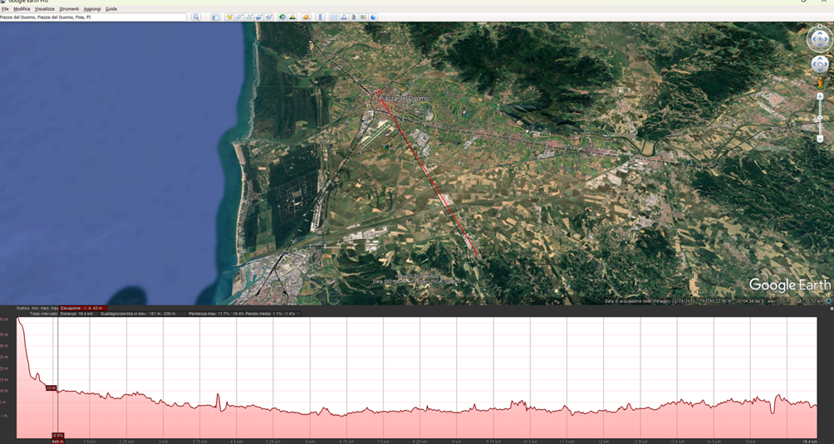
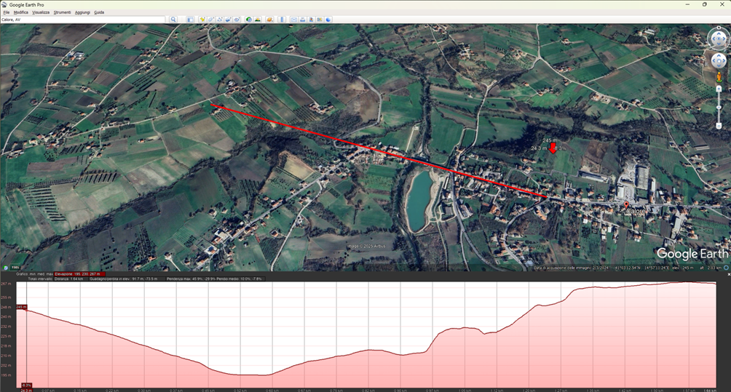
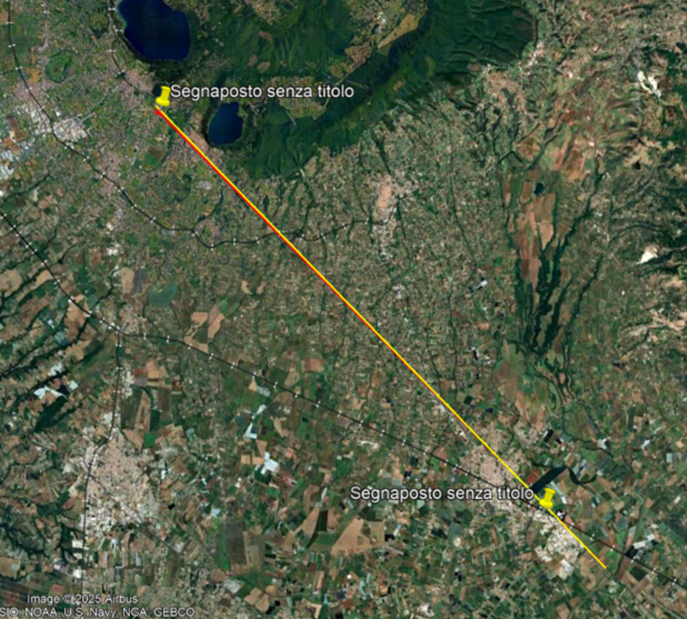
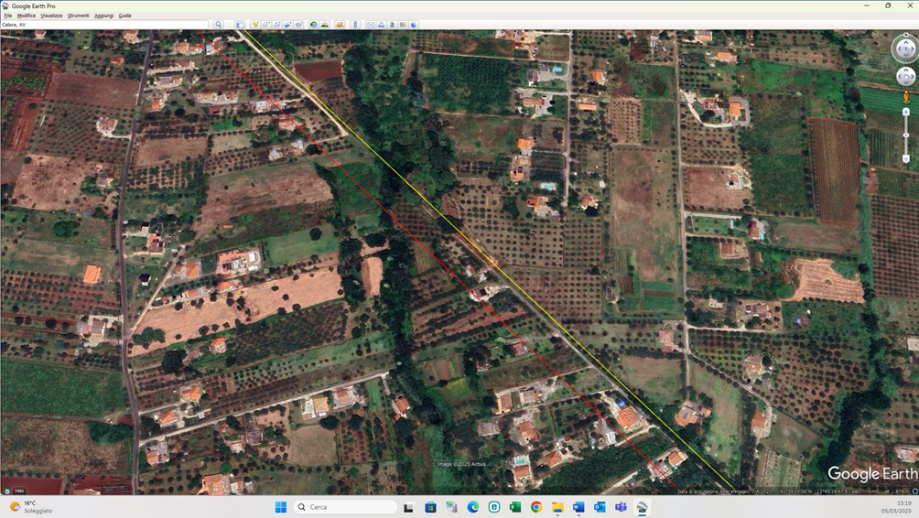
Collesalvetti
Calore
Cisterna Ariccia
Cisterna Ariccia (particolare)

Slide 32
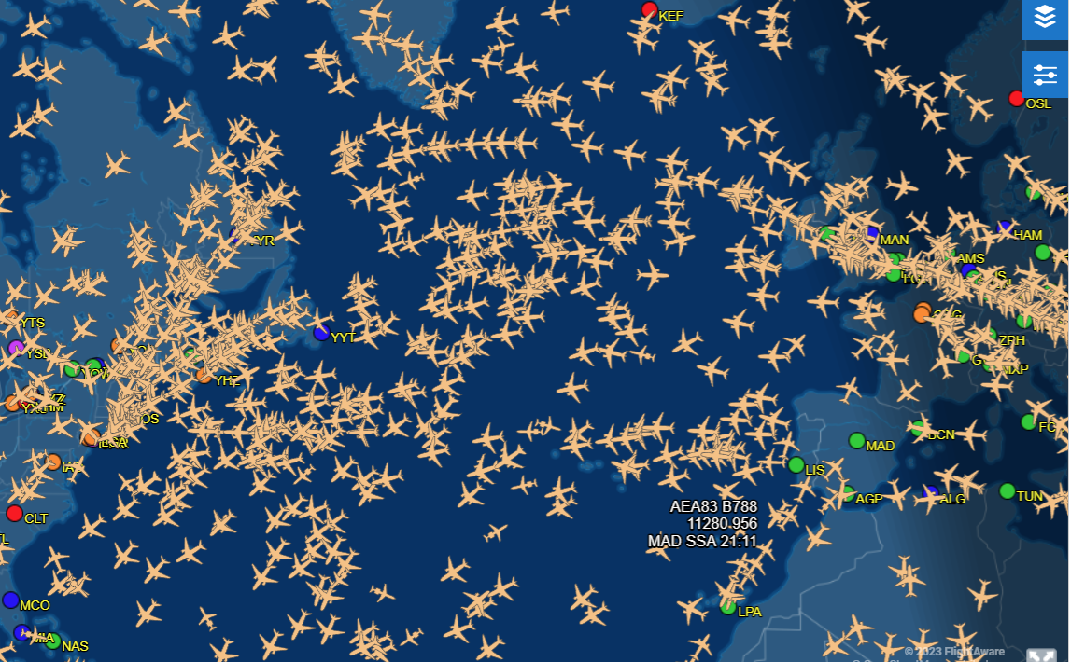
One difficulty to interpreter the map (from Flightaware)

Slide 33
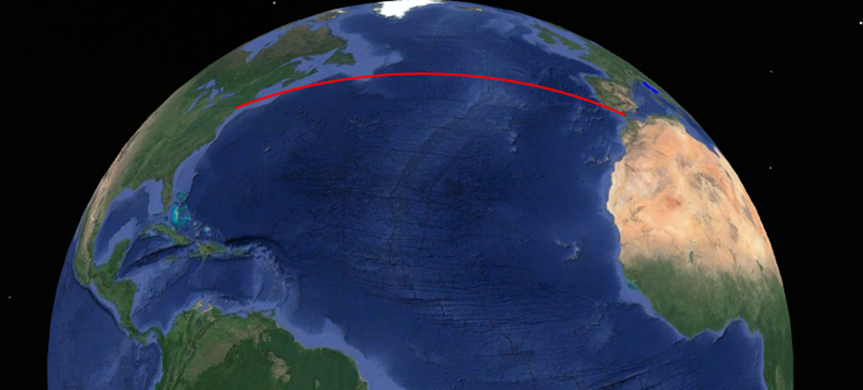
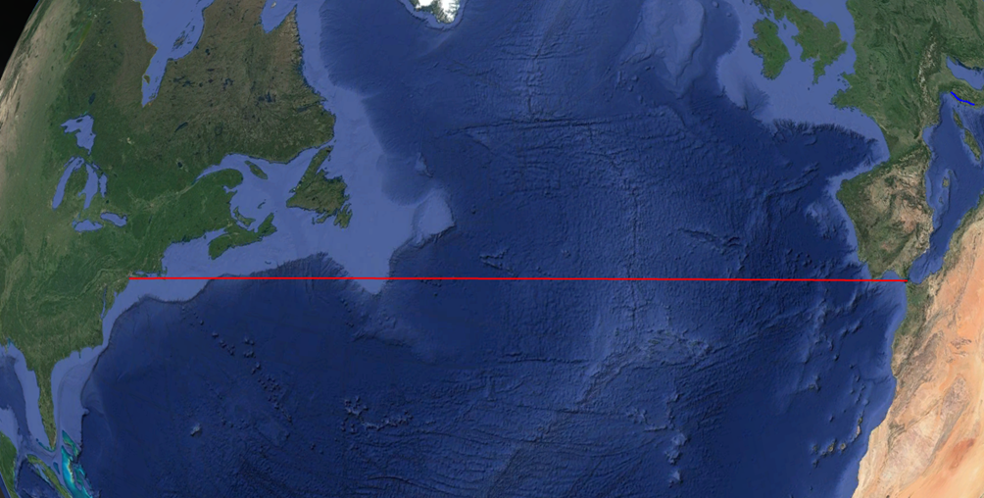
The theme of the very long paths

Slide 34
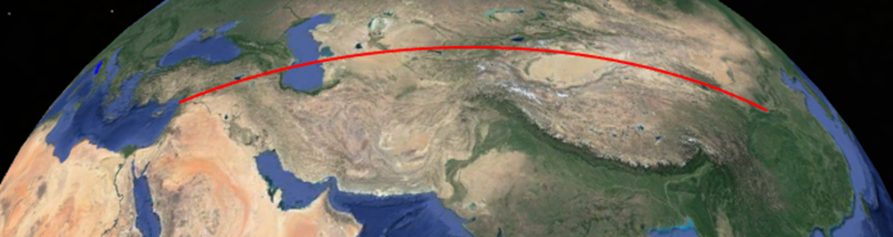
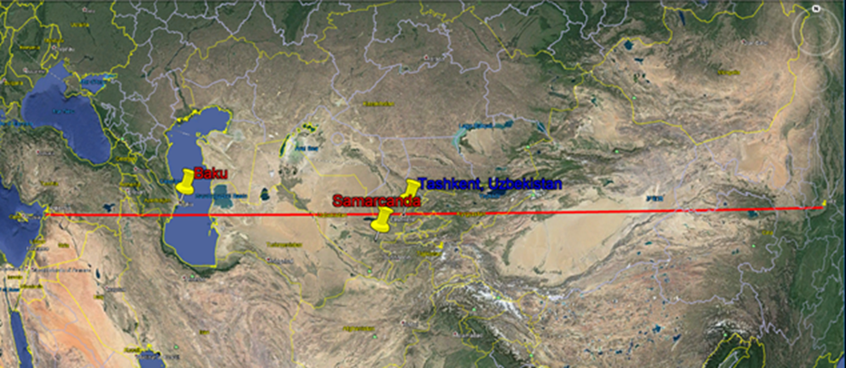
From China to Europe: Xi'an, Samarkand, Tashkent and Antioch

Slide 35
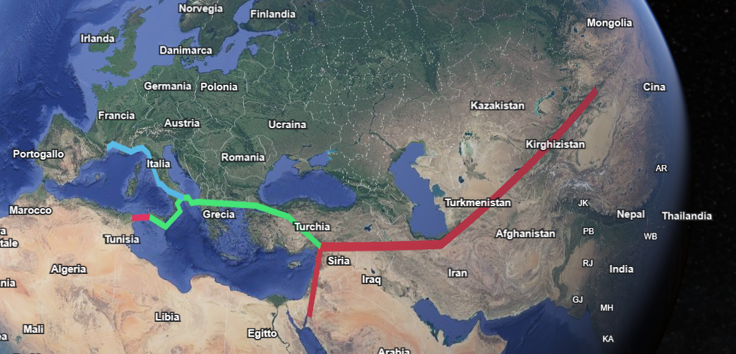
www, the world wide web of the prehistory

Slide 36
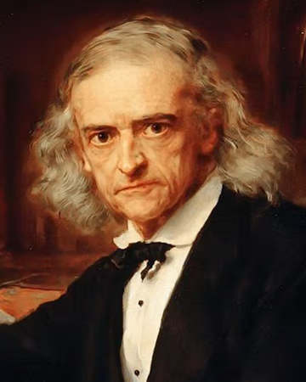
Why was Rome born – as Teodor Mommsen wondered – in such an inhospitable and marshy site?

Slide 37
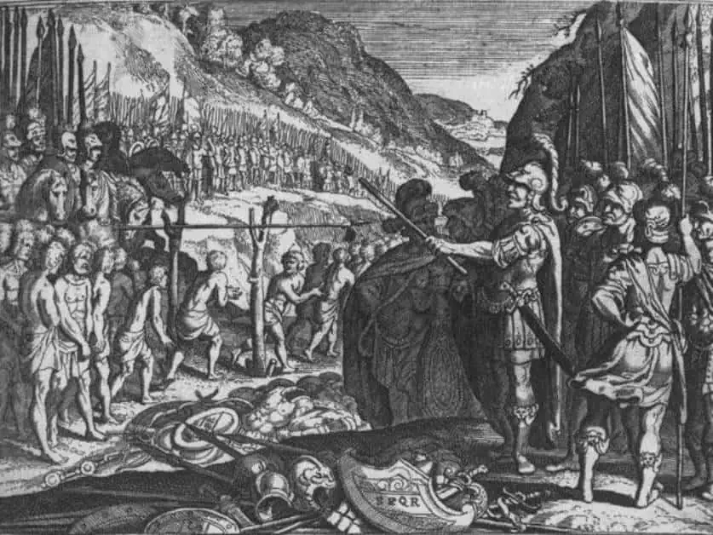
Why was Caudium so important for Roman expansion southwards?

Slide 38
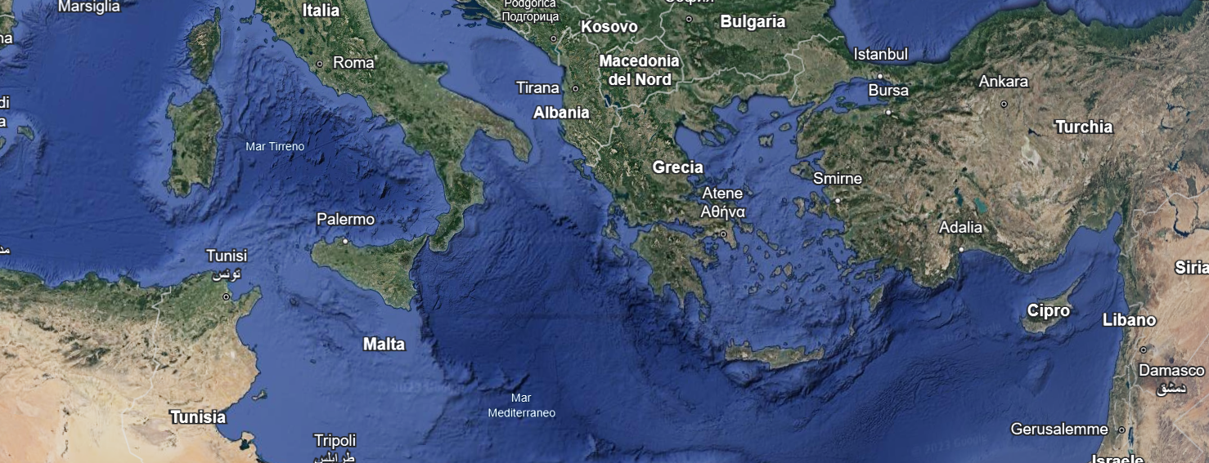
Why did most the major colonies of Magna Graecia arise along the Ionian coast and none on the Tyrrhenian coast?

Slide 39
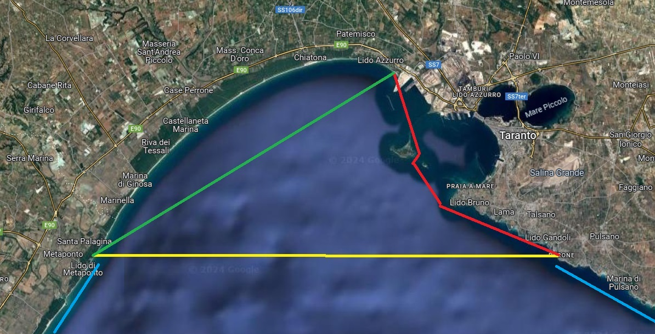
Why, according to the historians, the first settlements of Taranto was at the Tara River and at Saturo Bay?
Were then the historical cities stages between the orient and the center of the Mediterranean Sea or colonies?

Slide 40
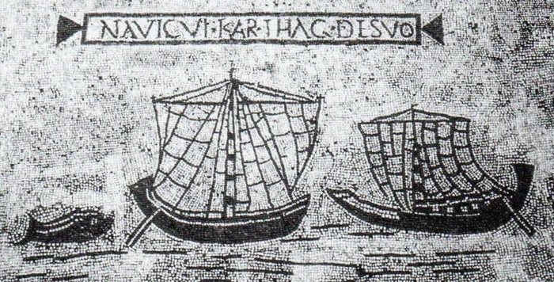
If the sea was almost unnavigable in winter, how could distant populations manage their activities and interests in such a way as to make the best use of the few months available for navigation?

Slide 41
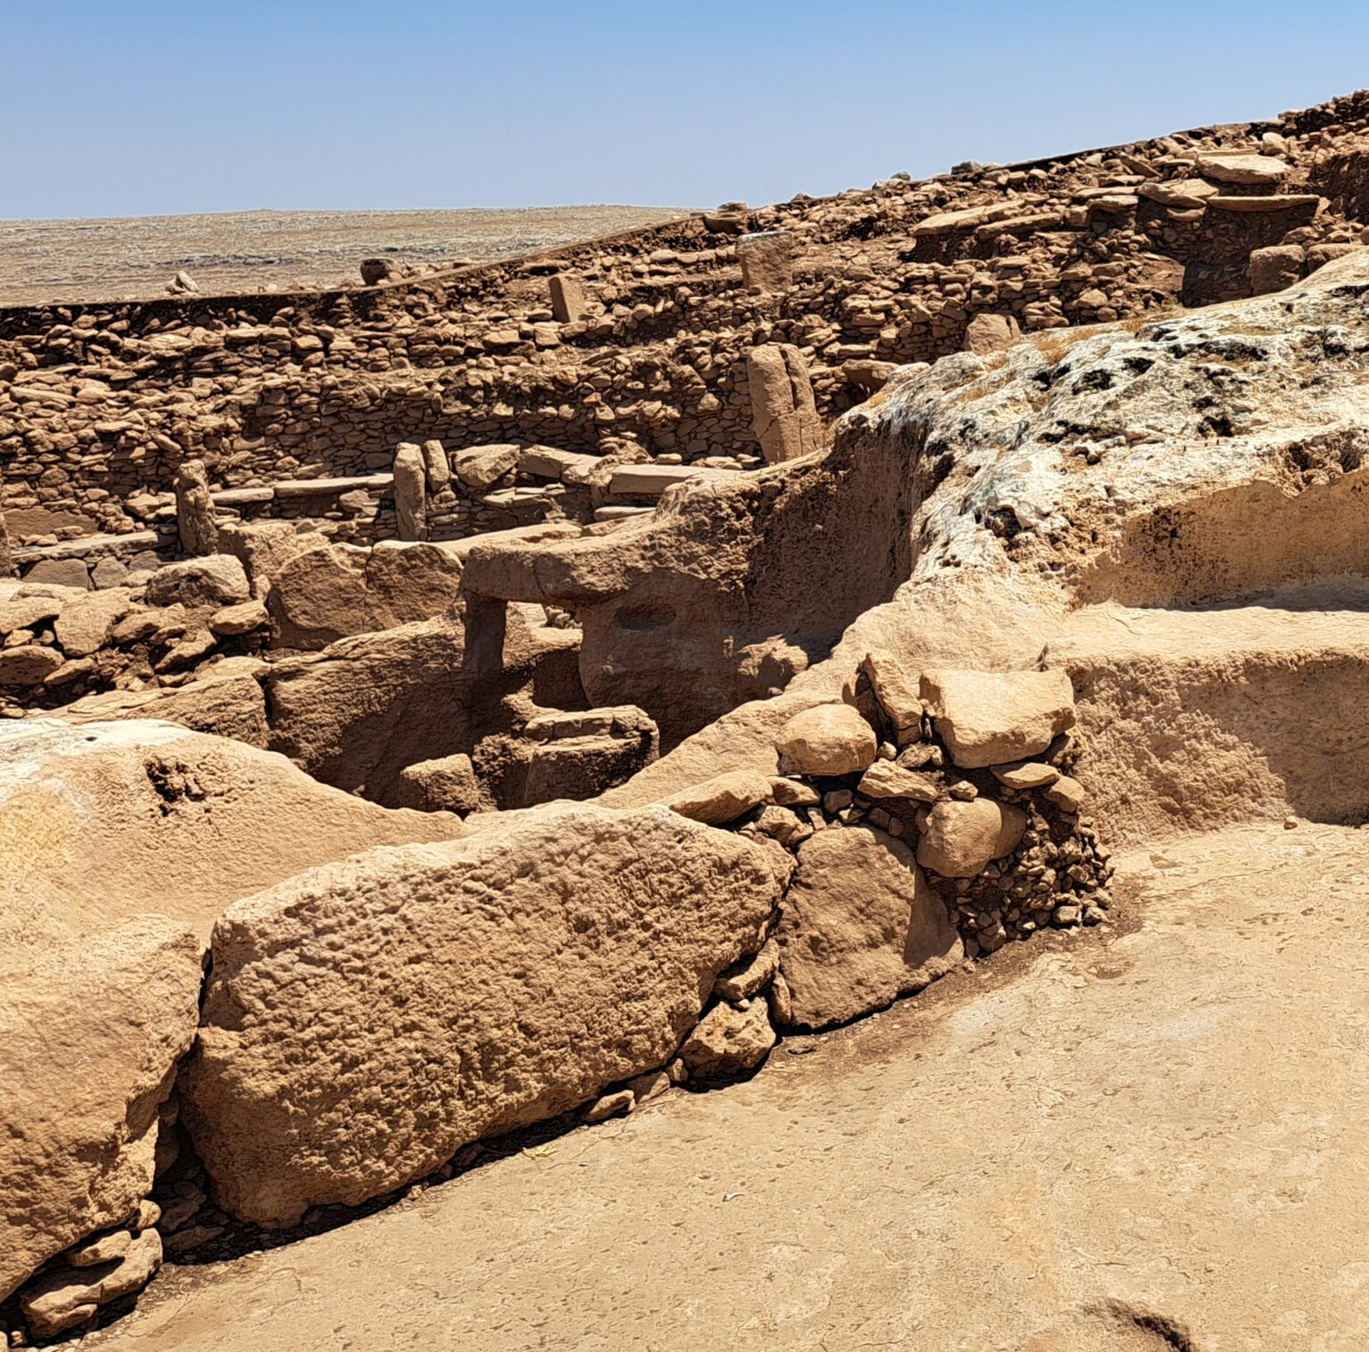
If these paths were so ancient and so extended, from the Pacific - through XI’an, Gobekli Tepe etc - to the Atlantic, then could we also rethink the epochal transition of prehistoric man from hunter-gatherers to not only farmer-breeders but also farmer-breeders - traveling merchants?

Slide 42
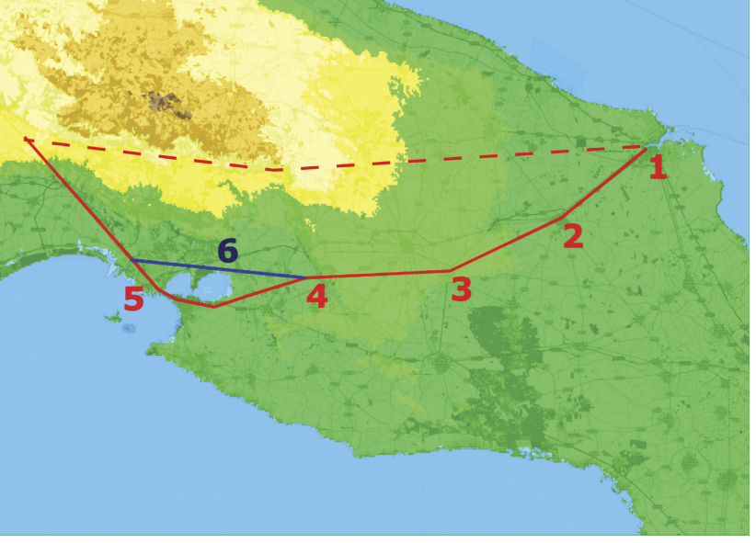
Why is the stretch of the Appian Way between Taranto and Brindisi not a straight line but a broken line? Which is the origin of Pezza Petrosa?

Slide 43
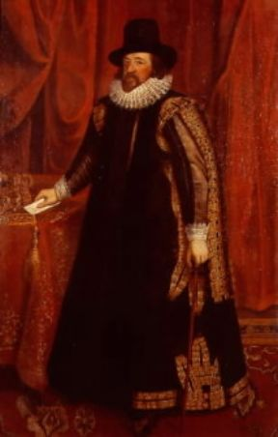
Antiquitas saeculi juventus mundi
Geopolitical Considerations
Philosophy of History Considerations
Method Considerations

Slide 44
